Slide 1

Bapatla Engineering College :: Bapatla, (Autonomous)
Department of Computer Science and Engineering
CAR PARKING SPACE DETECTION
UNDER THE GUIDANCE OF:
Mr. T. Y. SRINIVASA RAO
Assistant Professor
PRESENTED BY : C10 BATCH
P. Lakshmi Sahithi(Y20ACS533)
P. Hanumantha Rao(L21ACS414)
P. Vyshnavi(Y20ACS537)
Sk. Asifa(Y20ACS561)

Slide 2
CONTENTS
Abstract
Existing System
Proposed System
Design Methodology
Hardware And Software Requirements
Result
Conclusion

Slide 3
ABSTRACT
The objective is to develop a system that can accurately identify the availability of parking spaces in real-time, thereby enhancing the overall parking management process.
We propose an approach for car parking space detection using machine learning techniques.

Slide 4
EXISTING SYSTEM
Car Entry: The customer drives the car into the parking garage, and the system detects the presence of the car using IR sensors.
LED Indication: Green LEDs indicate available slots, and red LEDs indicate occupied slots, providing visual cues for slot availability.
Slot Availability Check: The driver or user checks for available parking slots using the LCD display, or Telnet application.

Slide 5
Start
Driver open the app’s
Slot Available?
No
Driver keeps looking for the available slot
Yes
Driver parks in the available slot
Car already parked?
No
Green Light==ON
Red Light==OFF
Yes
Green Light==OFF
Red Light==ON
End

Slide 6
Drawbacks
Limited Accuracy: IR sensors may have constraints in accurately detecting parked vehicles, leading to potential false positives or negatives.
Dependency on Hardware: The system heavily relies on physical components like IR sensors and microcontrollers, making it susceptible to malfunctions or damage.
Limited Scalability: Scaling the system to cover larger parking areas with numerous slots may pose challenges in terms of cost and complexity.
Static Configuration: System settings, such as IR sensor thresholds, remain fixed and may not adapt well to changing environmental conditions or parking dynamics.

Slide 7
Proposed System
Our proposed project focuses on developing a smart parking system leveraging machine learning, particularly Support Vector Machine (SVM), and computer vision techniques.
The system will utilize SVM algorithms and computer vision models to detect and classify parking space occupancy in real-time.
By analyzing live camera feeds, the system will accurately provide information about available parking spots.
The goal is to optimize parking space utilization and reduce congestion in urban areas.

Slide 8
DESIGN METHODOLOGY
Image and Video Upload
Connected Component Analysis
Bounding Box Extraction
Frame Processing
Spot Status Determination
Visualization

Slide 9
HARDWARE & SOFTWARE REQUIREMENTS
Hardware Requirements
Processor : 7th Gen Intel core i5 or Ryzen 5 or Higher.
Storage : 256 GB.
RAM : 8 GB.
Software Requirements
Operating System : Windows, macOS.
Packages : Numpy, Matplotlib, Scikit-learn, Scikit-image, Pandas.
WorkSpace : Jupyter Notebook or Google Colab.

Slide 10
RESULT
Steps involved in getting result:
Access Upload Page: Visit the upload page (/upload) in Flask application.
Select Files: Choose an image file containing the mask and a video file for detecting parking spots.
Upload Files: Submit the selected files through the upload form.
File Processing: The server processes the uploaded files, extracting information from the mask image and analyzing the video frames.
Spot Detection: Using computer vision techniques, the application identifies parking spots within the video frames.
Display Results: Processed video frames are displayed with rectangles indicating available in green rectangles and occupied in red rectangles around the parking spots.

Slide 11

After Opening The Website

Slide 12
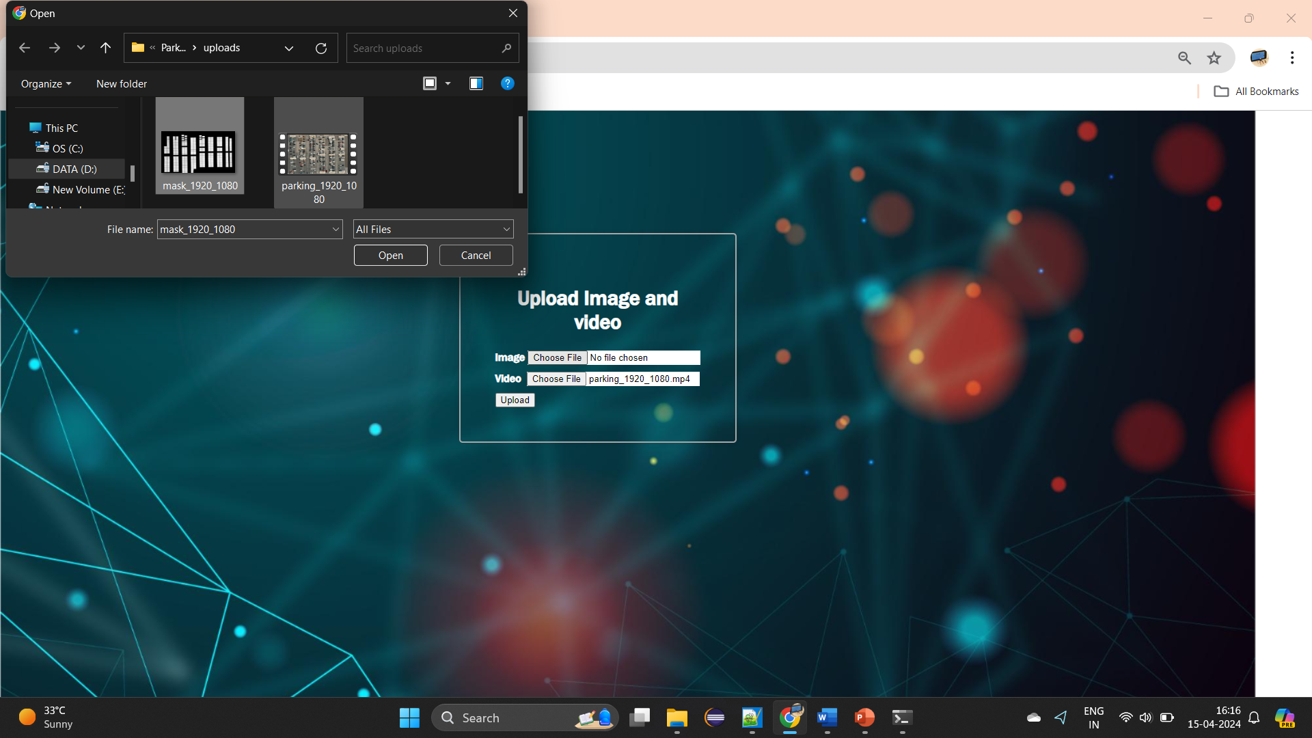
After successful login,user is allowed to upload the image and video

Slide 13
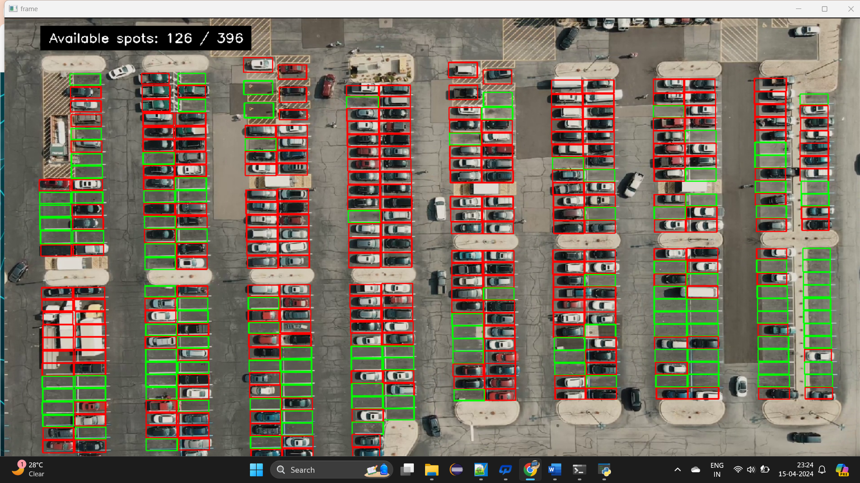
After successful video & Image uploading,the result as

Slide 14
Conclusion
The project utilizing computer vision and machine learning for car parking space detection presents a robust and efficient alternative to IoT-based systems. By utilizing hardware such as cameras and algorithms, the system achieves accurate real-time detection of parking spaces.
It offers adaptability to diverse parking environments, providing flexibility in deployment and configuration.With scalability features, the system can easily accommodate varying parking area sizes .
It’s low maintenance requirements make it a cost-effective solution compared to IoT-based alternatives.
Through this project, we aim to address challenges associated with traditional parking management systems and contribute to the development of smarter urban environments.

Slide 15


